Slide 1



E-Commerce Platform

Slide 2


Developed with:
Esmail Salah

Slide 3
Introduction
Today, I’ll be presenting an eCommerce project I developed using HTML, CSS, JavaScript, PHP, and MySQL. This project is aimed at creating a simple and user-friendly online shopping experience, where users can easily browse products, add items to their cart, and proceed to checkout smoothly.
The frontend of the site was built with HTML for structuring content, CSS for an appealing, responsive design, and JavaScript to add interactivity. For the backend, I utilized PHP to handle server-side logic, and MySQL to manage and store all the essential data such as product listings and orders.
The project’s primary focus was to create a seamless, efficient user experience, and it was designed to handle the fundamental operations of any eCommerce platform. I look forward to sharing more about the technical aspects, challenges, and future improvements of this project."

Slide 4


Tools & Techniques
HTML
CSS
PHP
JS
MySQL

Slide 5


SYSTEM SERVICES
Products
Shopping
Cart
Purchase
Admin Managment

Slide 6

Info database
3

Slide 7



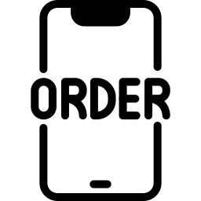
Tables
Product Table
Car Table
Order Table
Name: The name of the product.
Price: The product's price.
Image Url: URL to the product's image.
Name: The name of the product.
Price: The product's price.
Image Url: URL to the product's image.
Quantity: Quantity of the product in the cart.
Name: The name of the user.
Email: The email of the user.
Number: The user number.
Pay Method
Flat
Street
State
City
Country
Total Products
Total Price

Slide 8

Quick look for
project
3

Slide 9
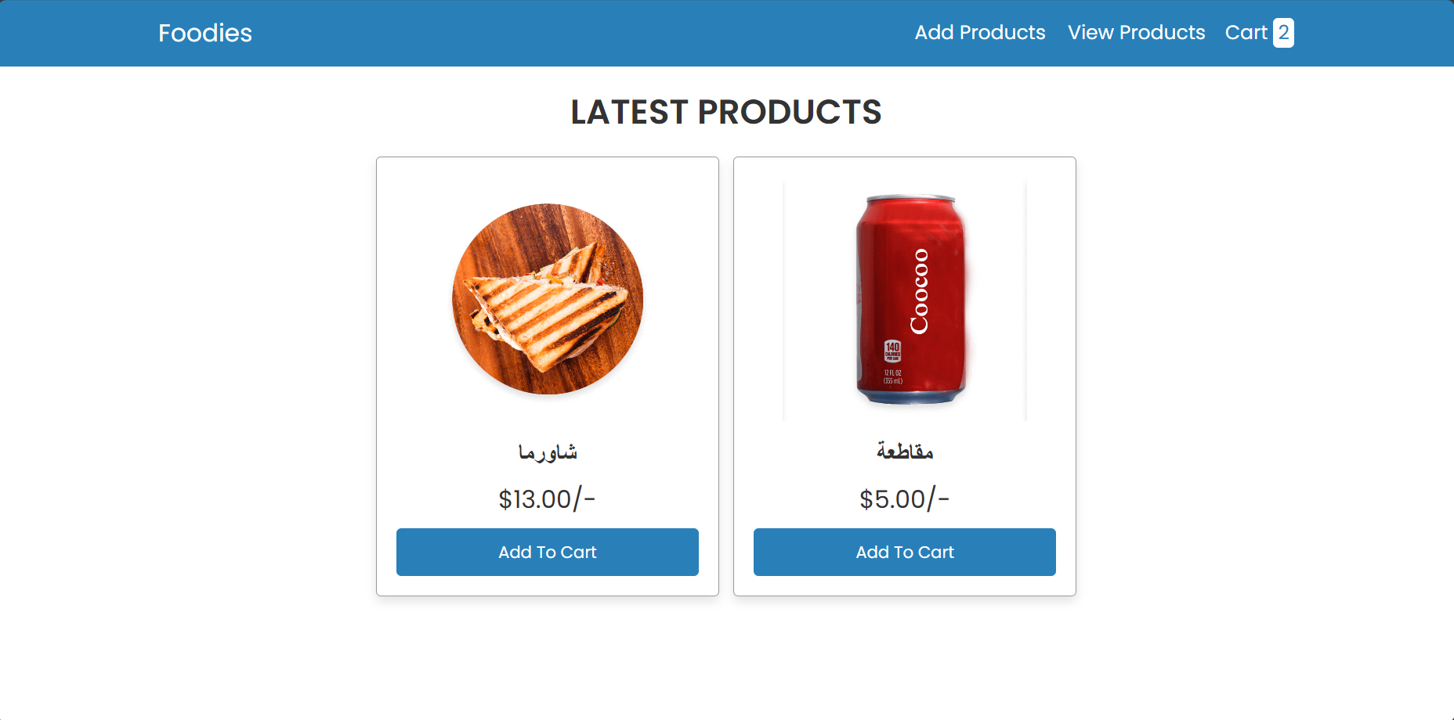
Home Page

Slide 10
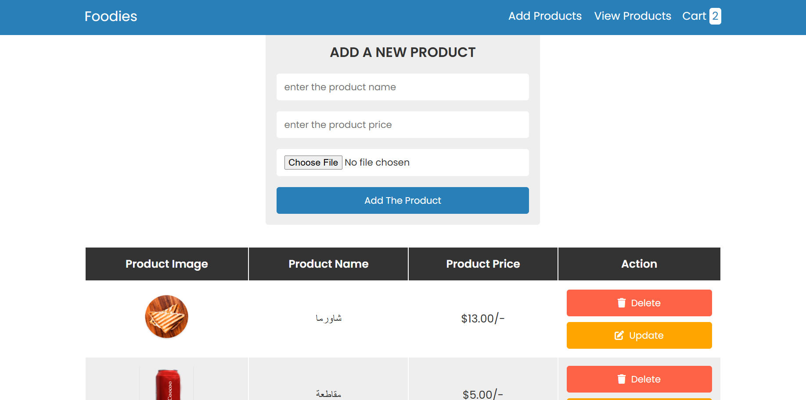
Admin Panel

Slide 11
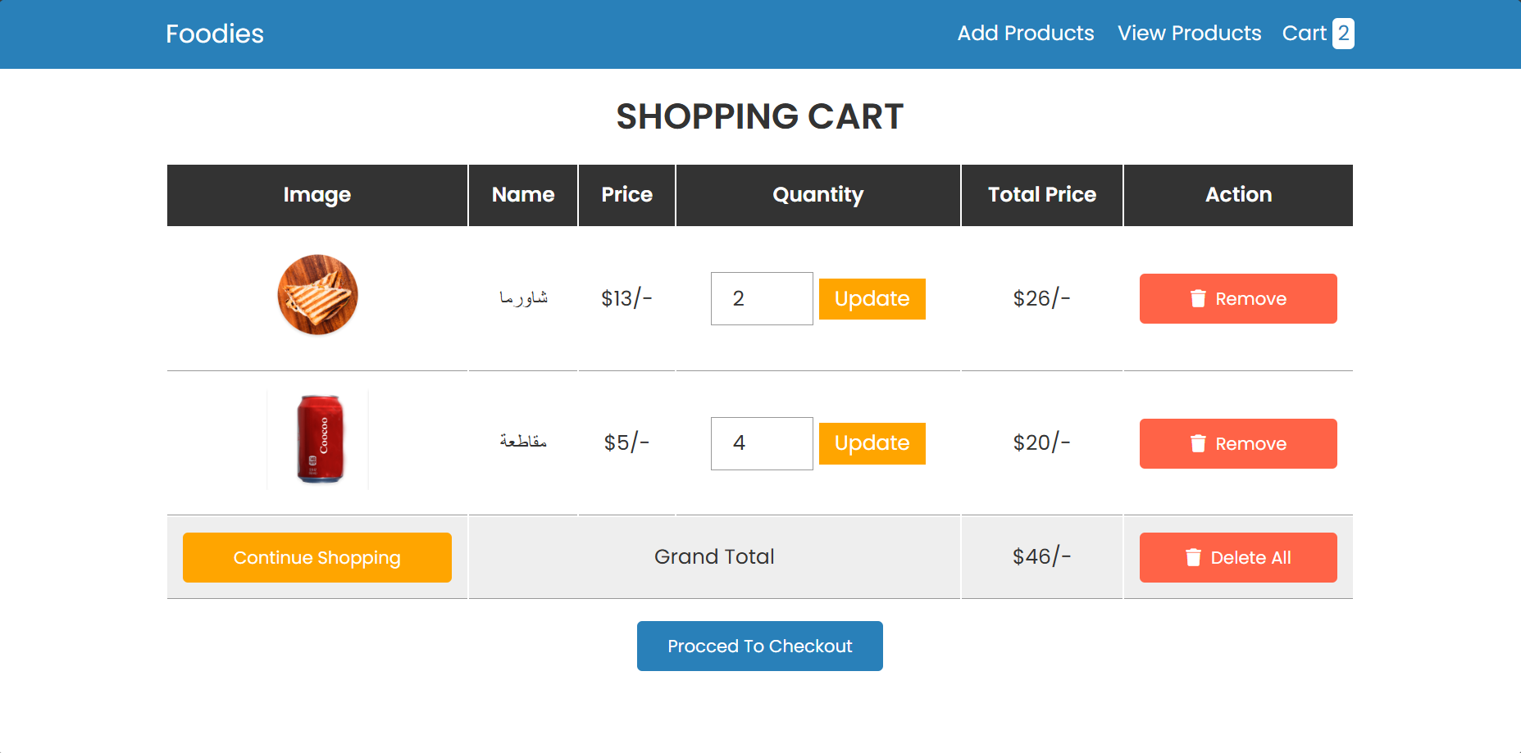
Shopping Cart

Slide 12
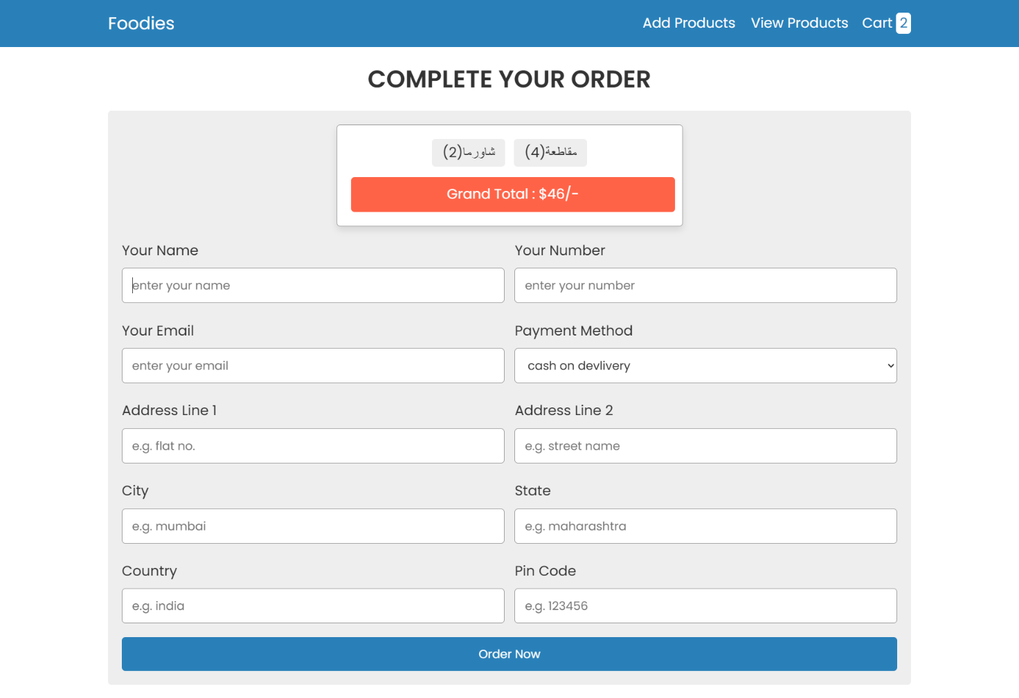
Payment

Slide 13

Thank
You

